Slide 1

Traffic Accidents Predictive Analysis of Canada
Yuxuan Liu
20090374

Slide 2
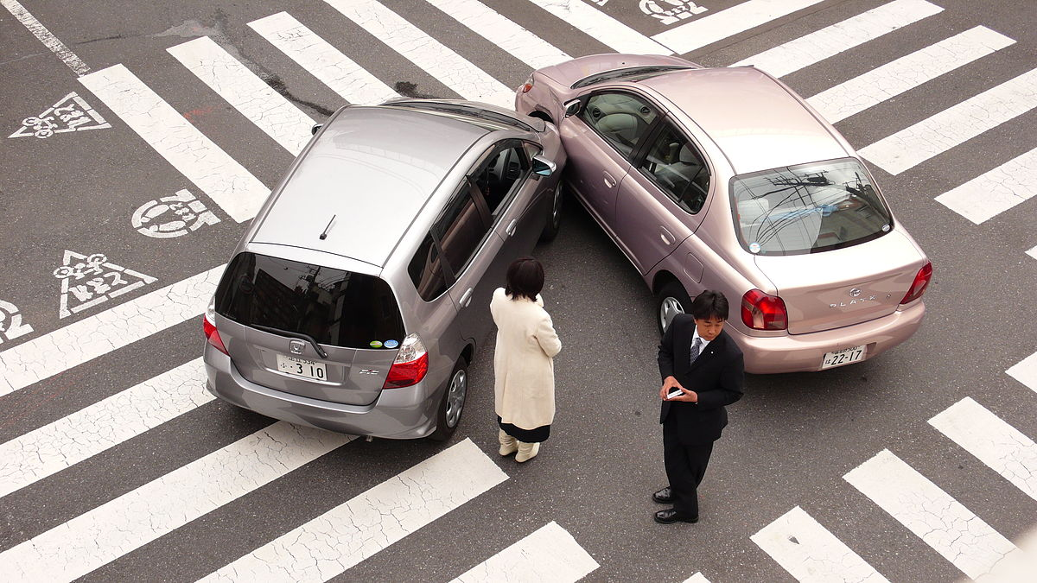
introduction

Slide 3
Data preprocessing
"C_YEAR", "C_MNTH", "C_WDAY", "C_HOUR", "C_WTHR", "C_RSUR",
"C_VEHS", "C_CONF", "C_RCFG", "C_RALN", "C_TRAF", "C_CASE"
"V_ID", "V_TYPE", "V_YEAR“
"P_ID", "P_SEX", "P_AGE", "P_PSN", "P_SAFE", "P_ISEV", "P_USER",

Slide 4
Data preprocessing
"C_YEAR", "C_MNTH", "C_WDAY", "C_HOUR", "C_WTHR", "C_RSUR",
"C_VEHS", "C_CONF", "C_RCFG", "C_RALN", "C_TRAF", "C_CASE"
"V_ID", "V_TYPE", "V_YEAR“
"P_ID", "P_SEX", "P_AGE", "P_PSN", "P_SAFE", "P_ISEV", "P_USER",

Slide 5
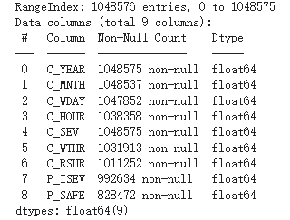
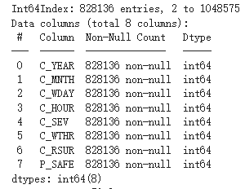
Data preprocessing

Slide 6
model
XGBoostingClassifier
RandomForestClassifier

Slide 7
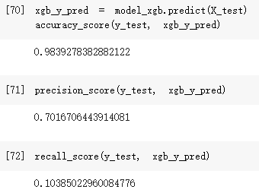
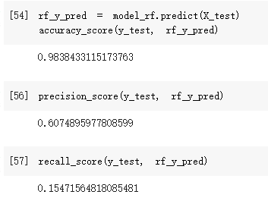
XGBOOSTING v.s. randomforest

Slide 8
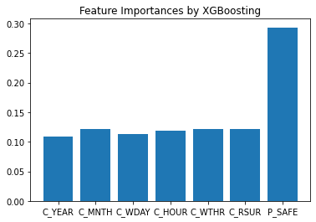
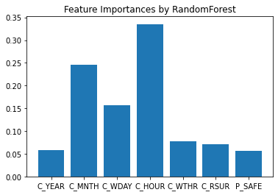
XGBOOSTING v.s. randomforest

Slide 9
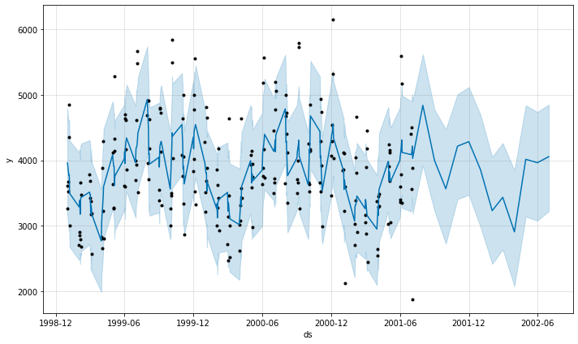
Time series
Prediction without yearly seasonality for future 1 year

Slide 10
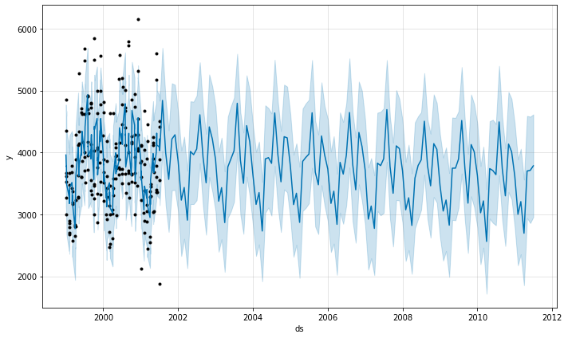
Time series
Prediction with yearly seasonality for future 10 years

Slide 11
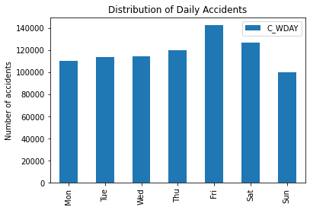
Other Observations

Slide 12
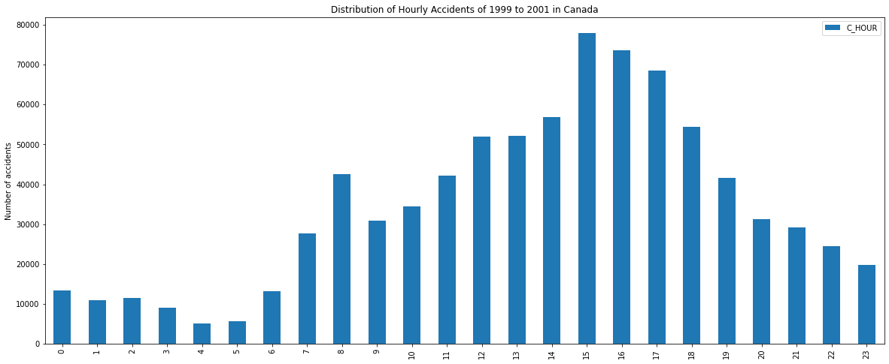
OTHER OBSERVATIONS

Slide 13
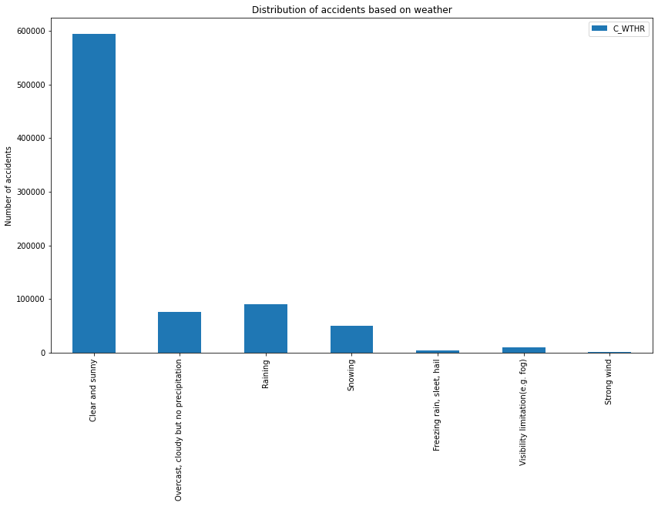
Other observations

Slide 14
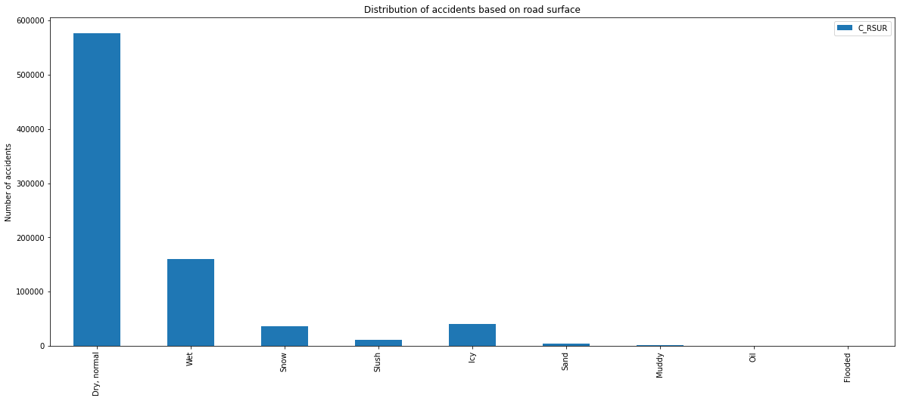
Other observations

Slide 15
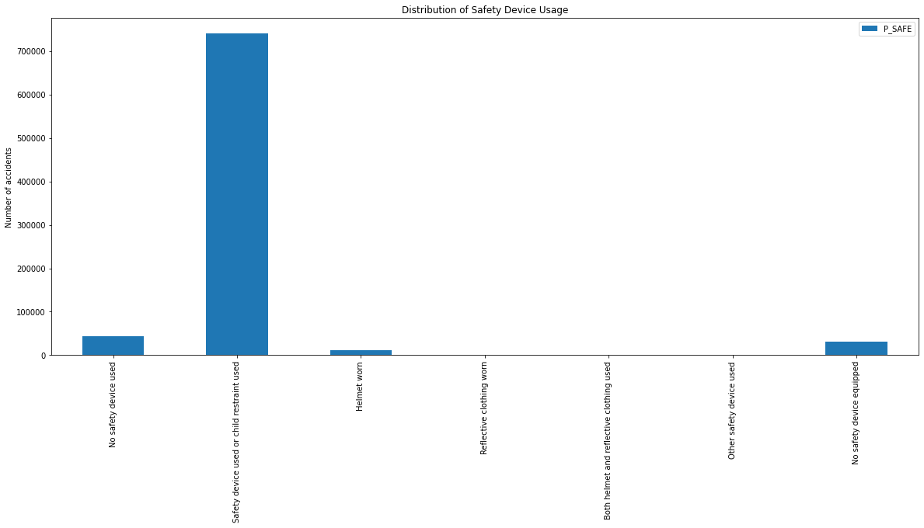
Other observations

Slide 16

Conclusion

